Slide 1

Sultan S. Alqahtani
Assistance Professor
PhD in Computer Science (Software Engineering)
ssalqahtani@imamu.edu.sa
Office: 3092

Slide 2
Course Information
Course Informationc
Credit Hours | 3 credit hours 3 hours regular lecture
Instructor | Name | Sultan Saud Alqahtani
 | Email | ssalqahtani@imamu.edu.sa
Textbook | Required | Ian Sommerville, Software Engineering, 9th edition, Addison Wesley, 2010
Pre-requisites | CS242 | Data Structures

Slide 3
Grade Scheme
Assessment | Assessment Task | Proportion
1 | Quizzes | 10%
2 | Midterm Exam | 25%
3 | Workshops | 5%
4 | Group Project | 20%
5 | Final Exam | 40%

Slide 4
Topics to be Covered
List of Topics | No. of Weeks | Contact hours
Introduction to software planning & management |  | 6
Software processes |  | 3
Agile software development |  | 3
Requirements engineering |  | 6
System modeling |  | 9
Architectural design |  | 3
Design & implementation |  | 6
Software testing & QA |  | 6
Software project management |  | 3

Slide 5
Introduction

Slide 6
What is Software?
The product that software professionals build and then support over the long term.
Software encompasses: (1) instructions (computer programs) that when executed provide desired features, function, and performance; (2) data structures that enable the programs to adequately store and manipulate information and (3) documentation that describes the operation and use of the programs.

Slide 7
Software products
Generic products
Stand-alone systems that are marketed and sold to any customer who wishes to buy them.
Examples – PC software such as editing, graphics programs, project management tools; CAD software; software for specific markets such as appointments systems for dentists.
Customized products
Software that is commissioned by a specific customer to meet their own needs.
Examples – embedded control systems, air traffic control software, traffic monitoring systems.

Slide 8
Why Software is Important?
The economies of ALL developed nations are dependent on software.
More and more systems are software controlled ( transportation, medical, telecommunications, military, industrial, entertainment,)
Software engineering is concerned with theories, methods and tools for professional software development.
Expenditure on software represents a significant fraction of Gross National Product (GNP in all developed countries.

Slide 9
Software costs
Software costs often dominate computer system costs. The costs of software on a PC are often greater than the hardware cost.
Software costs more to maintain than it does to develop. For systems with a long life, maintenance costs may be several times development costs.
Software engineering is concerned with cost-effective software development.

Slide 10
Features of Software?
Its characteristics that make it different from other things human being build.
Features of such logical system:
Software is developed or engineered, it is not manufactured in the classical sense which has quality problem.
Software doesn't "wear out.” but it deteriorates (due to change). Hardware has bathtub curve of failure rate ( high failure rate in the beginning, then drop to steady state, then cumulative effects of dust, vibration, abuse occurs).
Although the industry is moving toward component-based construction (e.g. standard screws and off-the-shelf integrated circuits), most software continues to be custom-built. Modern reusable components encapsulate data and processing into software parts to be reused by different programs. E.g. graphical user interface, window, pull-down menus in library etc.

Slide 11
Wear vs. Deterioration

Slide 12
Software Applications
1. System software: such as compilers, editors, file management utilities
2. Application software: stand-alone programs for specific needs.
3. Engineering/scientific software: Characterized by “number crunching”algorithms. such as automotive stress analysis, molecular biology, orbital dynamics etc
4. Embedded software resides within a product or system. (key pad control of a microwave oven, digital function of dashboard display in a car)
5. Product-line software focus on a limited marketplace to address mass consumer market. (word processing, graphics, database management)
6. WebApps (Web applications) network centric software. As web 2.0 emerges, more sophisticated computing environments is supported integrated with remote database and business applications.
7. AI software uses non-numerical algorithm to solve complex problem. Robotics, expert system, pattern recognition game playing

Slide 13
Software—New Categories
Open world computing—pervasive, ubiquitous, distributed computing due to wireless networking. How to allow mobile devices, personal computer, enterprise system to communicate across vast network.
Netsourcing—the Web as a computing engine. How to architect simple and sophisticated applications to target end-users worldwide.
Open source—”free” source code open to the computing community (a blessing, but also a potential curse!)
Also … (see Chapter 31)
Data mining
Grid computing
Cognitive machines
Software for nanotechnologies

Slide 14
Software Engineering Definition
The seminal definition:
[Software engineering is] the establishment and use of sound engineering principles in order to obtain economically software that is reliable and works efficiently on real machines.
The IEEE definition:
Software Engineering: (1) The application of a systematic, disciplined, quantifiable approach to the development, operation, and maintenance of software; that is, the application of engineering to software. (2) The study of approaches as in (1).

Slide 15
Importance of Software Engineering
More and more, individuals and society rely on advanced software systems. We need to be able to produce reliable and trustworthy systems economically and quickly.
It is usually cheaper, in the long run, to use software engineering methods and techniques for software systems rather than just write the programs as if it was a personal programming project. For most types of system, the majority of costs are the costs of changing the software after it has gone into use.

Slide 16
FAQ about software engineering
Question | Answer
What is software? | Computer programs, data structures and associated documentation. Software products may be developed for a particular customer or may be developed for a general market.
What are the attributes of good software? | Good software should deliver the required functionality and performance to the user and should be maintainable, dependable and usable.
What is software engineering? | Software engineering is an engineering discipline that is concerned with all aspects of software production.
What is the difference between software engineering and computer science? | Computer science focuses on theory and fundamentals; software engineering is concerned with the practicalities of developing and delivering useful software.
What is the difference between software engineering and system engineering? | System engineering is concerned with all aspects of computer-based systems development including hardware, software and process engineering. Software engineering is part of this more general process.

Slide 17
Essential attributes of good software
Product characteristic | Description
Maintainability | Software should be written in such a way so that it can evolve to meet the changing needs of customers. This is a critical attribute because software change is an inevitable requirement of a changing business environment.
Dependability and security | Software dependability includes a range of characteristics including reliability, security and safety. Dependable software should not cause physical or economic damage in the event of system failure. Malicious users should not be able to access or damage the system.
Efficiency | Software should not make wasteful use of system resources such as memory and processor cycles. Efficiency therefore includes responsiveness, processing time, memory utilisation, etc.
Acceptability | Software must be acceptable to the type of users for which it is designed. This means that it must be understandable, usable and compatible with other systems that they use.

Slide 18
A Layered Technology
Software Engineering
tools
methods
process model
a “quality” focus
Any engineering approach must rest on organizational commitment to quality which fosters a continuous process improvement culture.
Process layer as the foundation defines a framework with activities for effective delivery of software engineering technology. Establish the context where products (model, data, report, and forms) are produced, milestone are established, quality is ensured and change is managed.
Method provides technical how-to’s for building software. It encompasses many tasks including communication, requirement analysis, design modeling, program construction, testing and support.
Tools provide automated or semi-automated support for the process and methods.

Slide 19
Case studies
A personal insulin pump
An embedded system in an insulin pump used by diabetics to maintain blood glucose control.
A mental health case patient management system
A system used to maintain records of people receiving care for mental health problems.
A wilderness weather station
A data collection system that collects data about weather conditions in remote areas.

Slide 20
Insulin pump control system
Collects data from a blood sugar sensor and calculates the amount of insulin required to be injected.
Calculation based on the rate of change of blood sugar levels.
Sends signals to a micro-pump to deliver the correct dose of insulin.
Safety-critical system as low blood sugars can lead to brain malfunctioning, coma and death; high-blood sugar levels have long-term consequences such as eye and kidney damage.

Slide 21
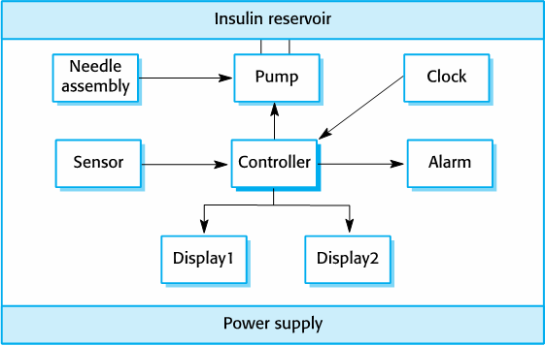
Insulin pump hardware architecture

Slide 22
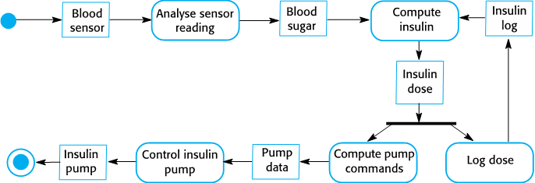
Activity model of the insulin pump

Slide 23
A patient information system for mental health care
A patient information system to support mental health care is a medical information system that maintains information about patients suffering from mental health problems and the treatments that they have received.
Most mental health patients do not require dedicated hospital treatment but need to attend specialist clinics regularly where they can meet a doctor who has detailed knowledge of their problems.
To make it easier for patients to attend, these clinics are not just run in hospitals. They may also be held in local medical practices or community centres.

Slide 24
MHC-PMS
The MHC-PMS (Mental Health Care-Patient Management System) is an information system that is intended for use in clinics.
It makes use of a centralized database of patient information but has also been designed to run on a PC, so that it may be accessed and used from sites that do not have secure network connectivity.
When the local systems have secure network access, they use patient information in the database but they can download and use local copies of patient records when they are disconnected.

Slide 25
MHC-PMS goals
To generate management information that allows health service managers to assess performance against local and government targets.
To provide medical staff with timely information to support the treatment of patients.

Slide 26
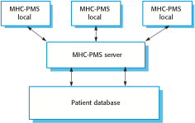
The organization of the MHC-PMS

Slide 27
MHC-PMS concerns
Privacy
It is essential that patient information is confidential and is never disclosed to anyone apart from authorised medical staff and the patient themselves.
Safety
Some mental illnesses cause patients to become suicidal or a danger to other people. Wherever possible, the system should warn medical staff about potentially suicidal or dangerous patients.
The system must be available when needed otherwise safety may be compromised and it may be impossible to prescribe the correct medication to patients.

Slide 28
Wilderness weather station
Home assignment (reading) ☺

